Slide 1

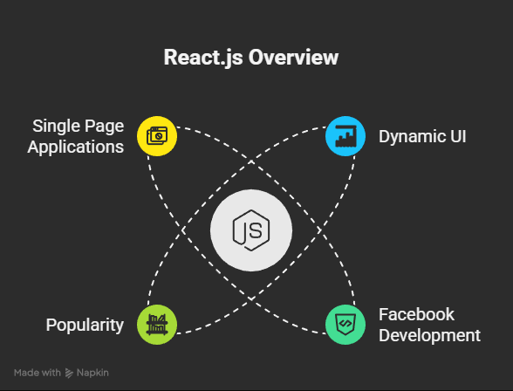
1. What is React
JavaScript library to build Dynamic and interactive user interfaces
Developed at Facebook in 2011.
Currently most widely used JS library for front-end development.
Used to create single page application (page does not re-load).

Slide 2

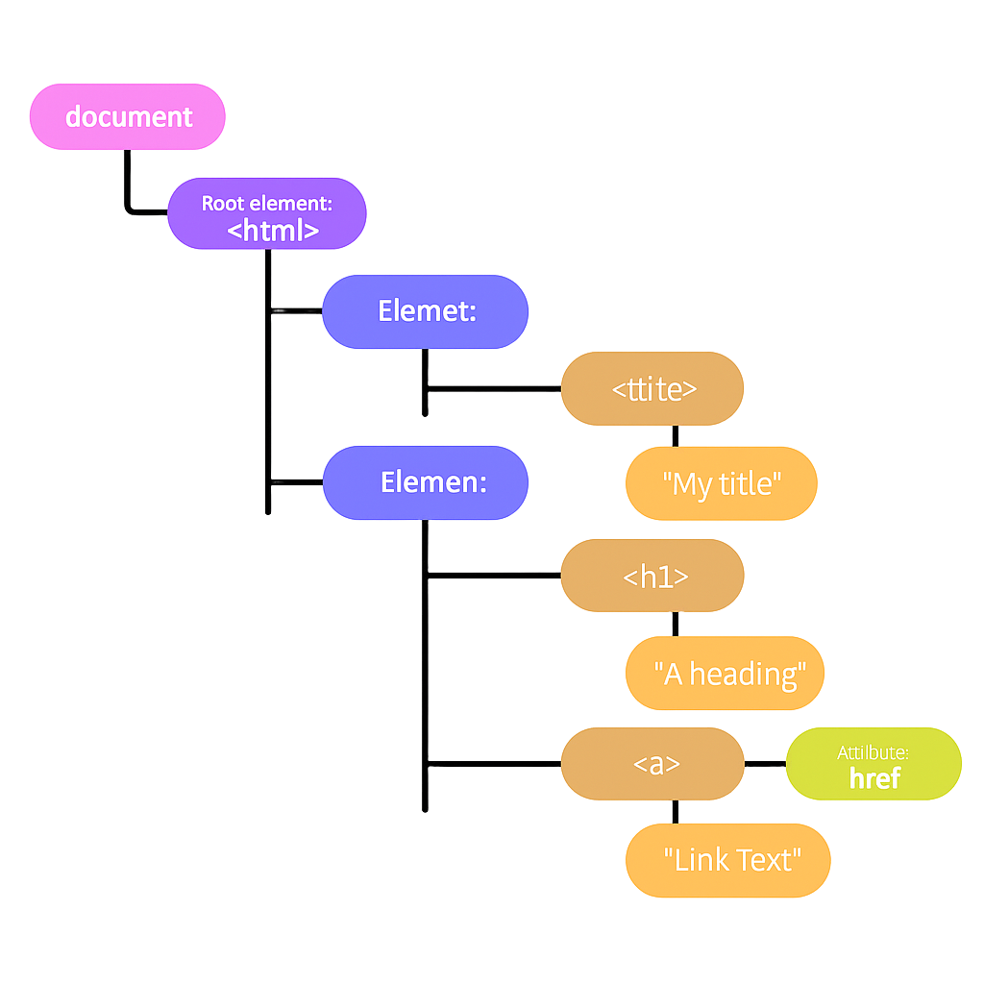
2. Working of DOM
Browser takes HTML and create DOM.
JS helps us modify DOM based on user actions or events.
In big applications, Working with DOM becomes complicated.

Slide 3

3. Problems with JavaScript
Complex UI Logic: Managing DOM, state, and updates manually is difficult.
Error-Prone & Hard to Debug: Minor mistakes can break entire features.
Poor Maintainability: Code becomes messy & unmanageable as grows.
Low Reusability: No standard
way to reuse UI or logic efficiently.
5. Manual DOM Manipulation:
Time-consuming and
performance-intensive.

Slide 4

4. Working of React
No need to manually query or update DOM elements.
React simplifies development by using
small, reusable components.
3. React efficiently handles the creation
and updating of DOM elements for you.
4. It saves significant development time -
most things are pre-built and
easier to manage.

Slide 5
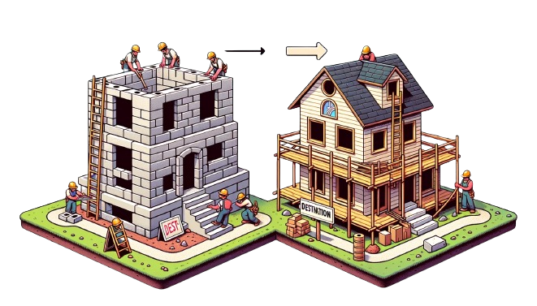
5. JS Vs React
JS is imperative: You define steps to reach your desired state.
React is Declarative: You define the target UI state and then react figures out how to reach that state.

Slide 6

6. Introduction to Components
Components help us write reusable, modular and better organized code.

Slide 7

6. Introduction to Components

Slide 8

6. Introduction to Components
React application is a tree of components with App Component as the root bringing everything together.

Slide 9

Create a React App
7. Setup IDE
8. Create a React App
9. Project Structure

Slide 10

7. What is IDE
IDE stands for Integrated Development Environment.
Software suite that consolidates basic tools
required for software development.
Central hub for coding, finding
problems, and testing.
Designed to improve developer efficiency.

Slide 11
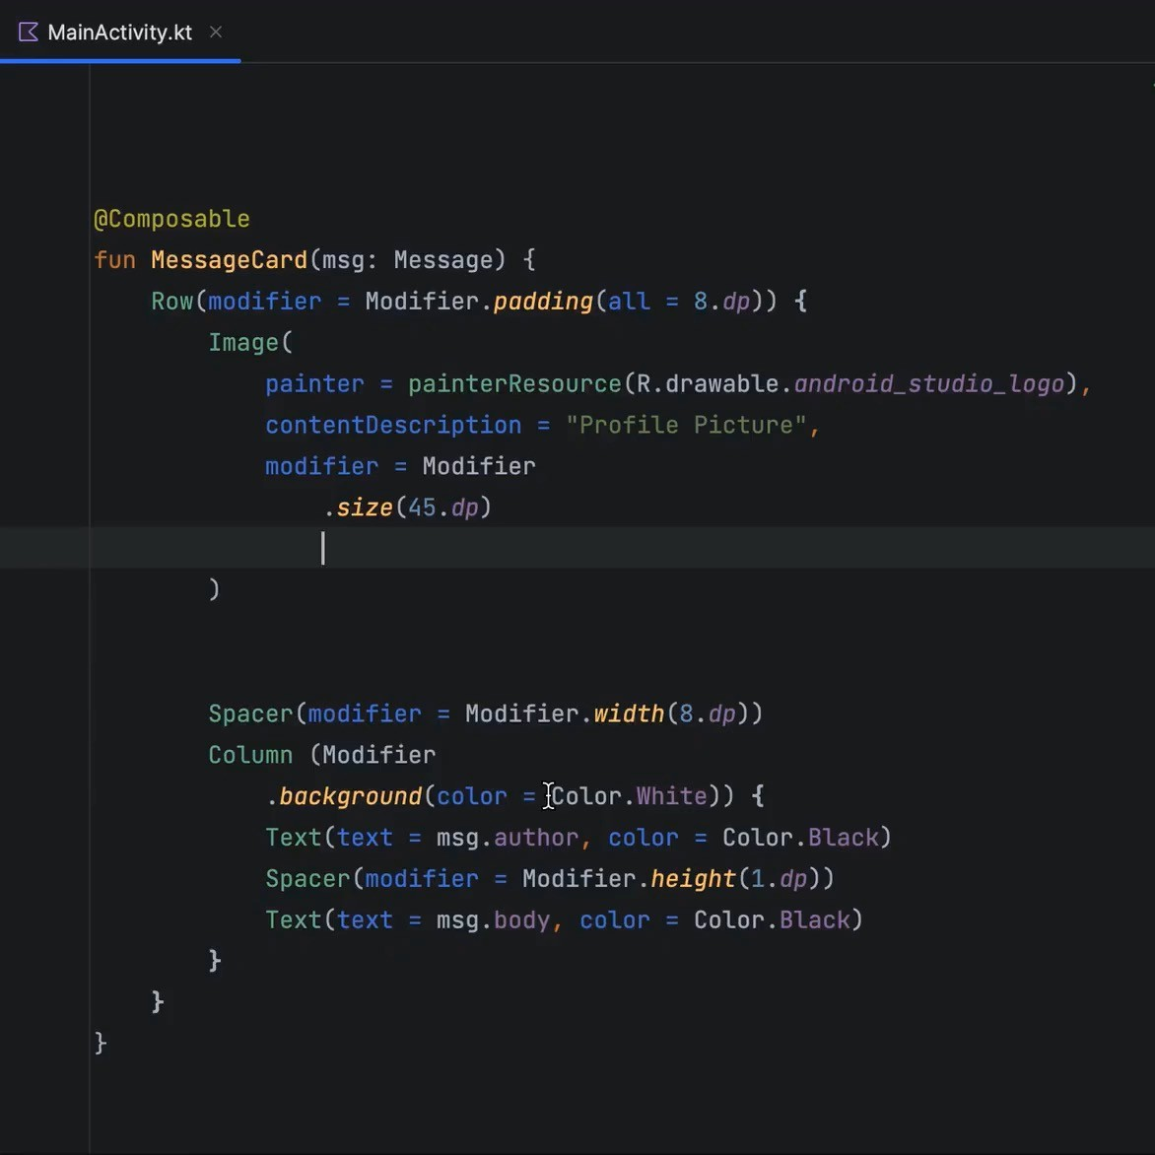
7. Need of IDE
Streamlines development.
Increases productivity.
Simplifies complex tasks.
Offers a unified workspace.
IDE Features
Code Autocomplete
Syntax Highlighting
Version Control
Error Checking

Slide 12


7. Install latest Node
Search
Download
NodeJS

Slide 13

7. Installation & Setup
Search VS Code
Keep Your
Software up to date

Slide 14


7. VsCode Extensions and Settings
Live Server / Live Preview
Prettier (Format on Save)
Line Wrap
Tab Size from 4 to 2

Slide 15


8. Create a React App
Official tool is CRA(Create React APP)
Vite is a modern tool to create React Project.
Vite produces Quick and Small bundle size.
Vite: Use npm run dev to launch dev server.
Use npm start for CRA.

Slide 16
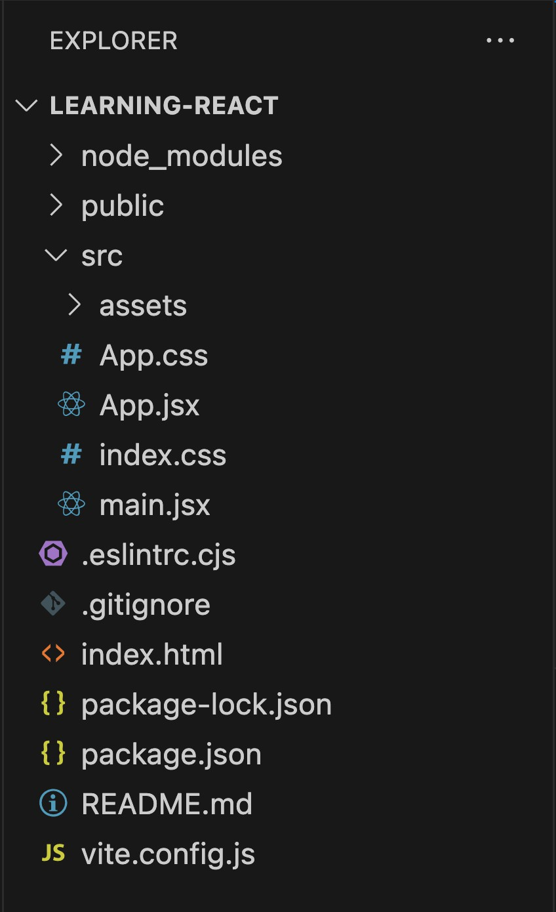
9. Project Structure
node_modules/ has all the installed node packages
public/ Directory: Contains static files that don't change.
src/ Directory: Main folder for the React code.
components/: Reusable parts of the UI, like buttons or headers.
assets/: Images, fonts, and other static files.
styles/: CSS or stylesheets.
package.json contains information about this project like name, version, dependencies on other react packages.
vite.config.js contains vite config.

Slide 17


10. File Extensions
.JS
Stands for JavaScript
Contains regular JavaScript code
Used for general logic and components
.JSX
Stands for JavaScript XML
Combines JavaScript with HTML-like tags
Makes it easier to design UI components

Slide 18

11. Class vs Function Components
Class Components
Stateful: Can manage state.
Lifecycle: Access to lifecycle methods.
Verbose: More boilerplate code.
Not Preferred anymore.
Functional Components
Initially stateless.
Can use Hooks for state and effects.
Simpler and more concise.
More Popular.

Slide 19

12. What is JSX?
Definition: JSX determines how the UI will look wherever the component is used.
Not HTML: Though it resembles HTML, you're actually writing JSX, which stands for JavaScript XML.
Conversion: JSX gets converted to regular JavaScript.
Babeljs.io/repl is a tool that allows you to see how JSX is transformed into JavaScript.

Slide 20
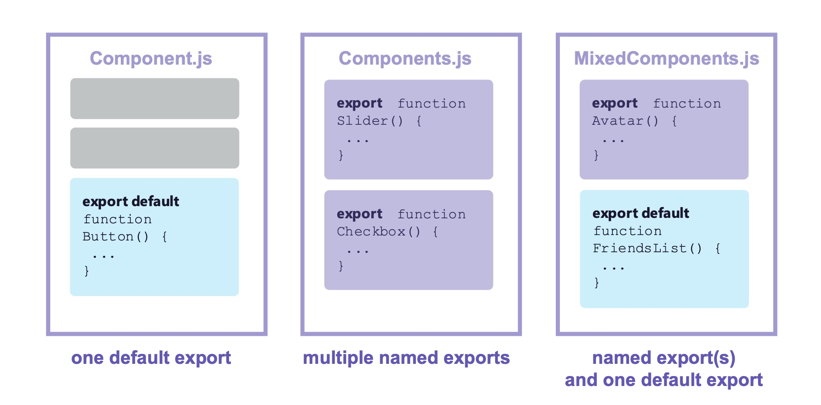

13. Exporting components
Enables the use of a component in other parts.
Default Export: Allows exporting a single component as the default from a module.
Named Export: Allows exporting multiple items from a module.
Importing: To use an exported component, you need to import it in the destination file using import syntax.

Slide 21

14. Other important Points
Naming: Must be capitalized; lowercase for default HTML.
HTML: Unlike vanilla JS where you can't directly write HTML, in React, you can embed HTML-like syntax using
JSX.
CSS: In React, CSS can be directly imported into component files, allowing for modular and component-specific styling.

Slide 22

15. Dynamic Components
Dynamic Content: JSX allows the creation of dynamic and interactive UI components.
JavaScript Expressions: Using {}, we can embed any JS expression
directly within JSX. This includes variables, function calls, and more.

Slide 23
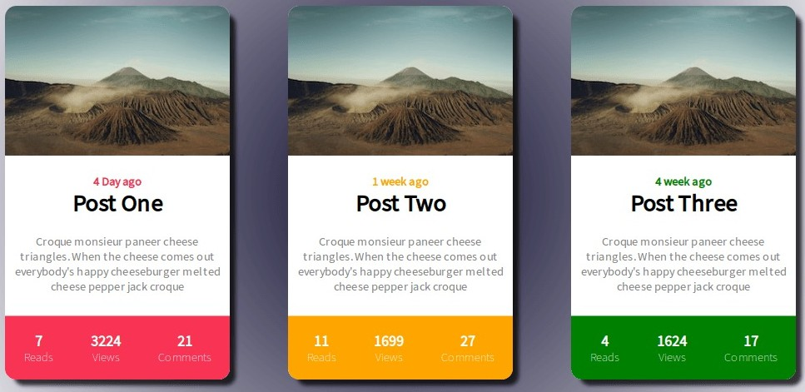
16. Reusable Components
Modularity: Components are modular, allowing for easy reuse across different parts of an application.
Consistency: Reusing components ensures UI consistency and reduces the chance of discrepancies.
Efficiency: Reduces development time and
effort by avoiding duplication of code.
Maintainability: Changes made to a reused component reflect everywhere it's used, simplifying updates and bug fixes.

Slide 24

17. Including Bootstrap
Responsive: Mobile-first design for all device sizes.
Components: Pre-styled elements like buttons and navbars.
Customizable: Modify default styles as needed.
Cross-Browser: Consistent look across browsers.
Open-Source: Free with community support.
Install:
npm i bootstrap@5.3.2
import
import "bootstrap/dist/css/bootstrap.min.css";

Slide 25
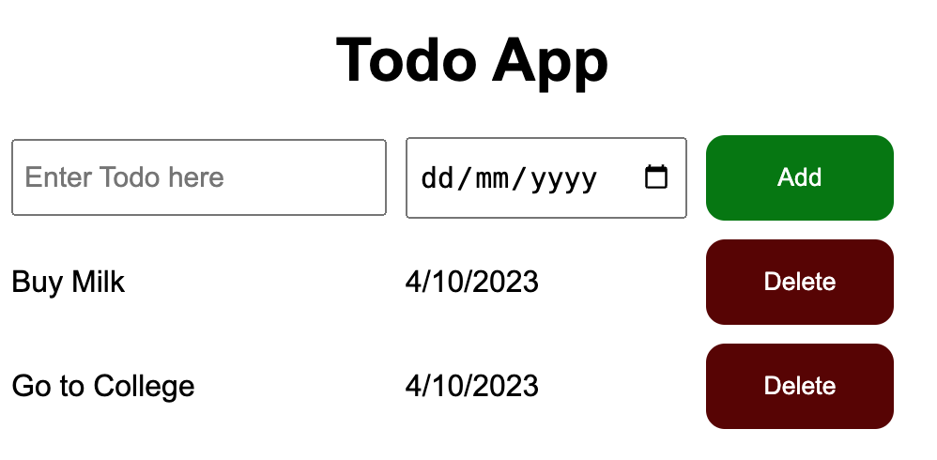
Project: TODO App UI

Slide 26

Project: Clock

Slide 27

18. Fragments
What?
Allows grouping of multiple elements without extra DOM nodes.
Why?
Return multiple elements without a wrapping parent.
Cleaner DOM and consistent styling.
How? Two syntaxes:
<React.Fragment>...</React.Fragment>
Short: <>...</>

Slide 28
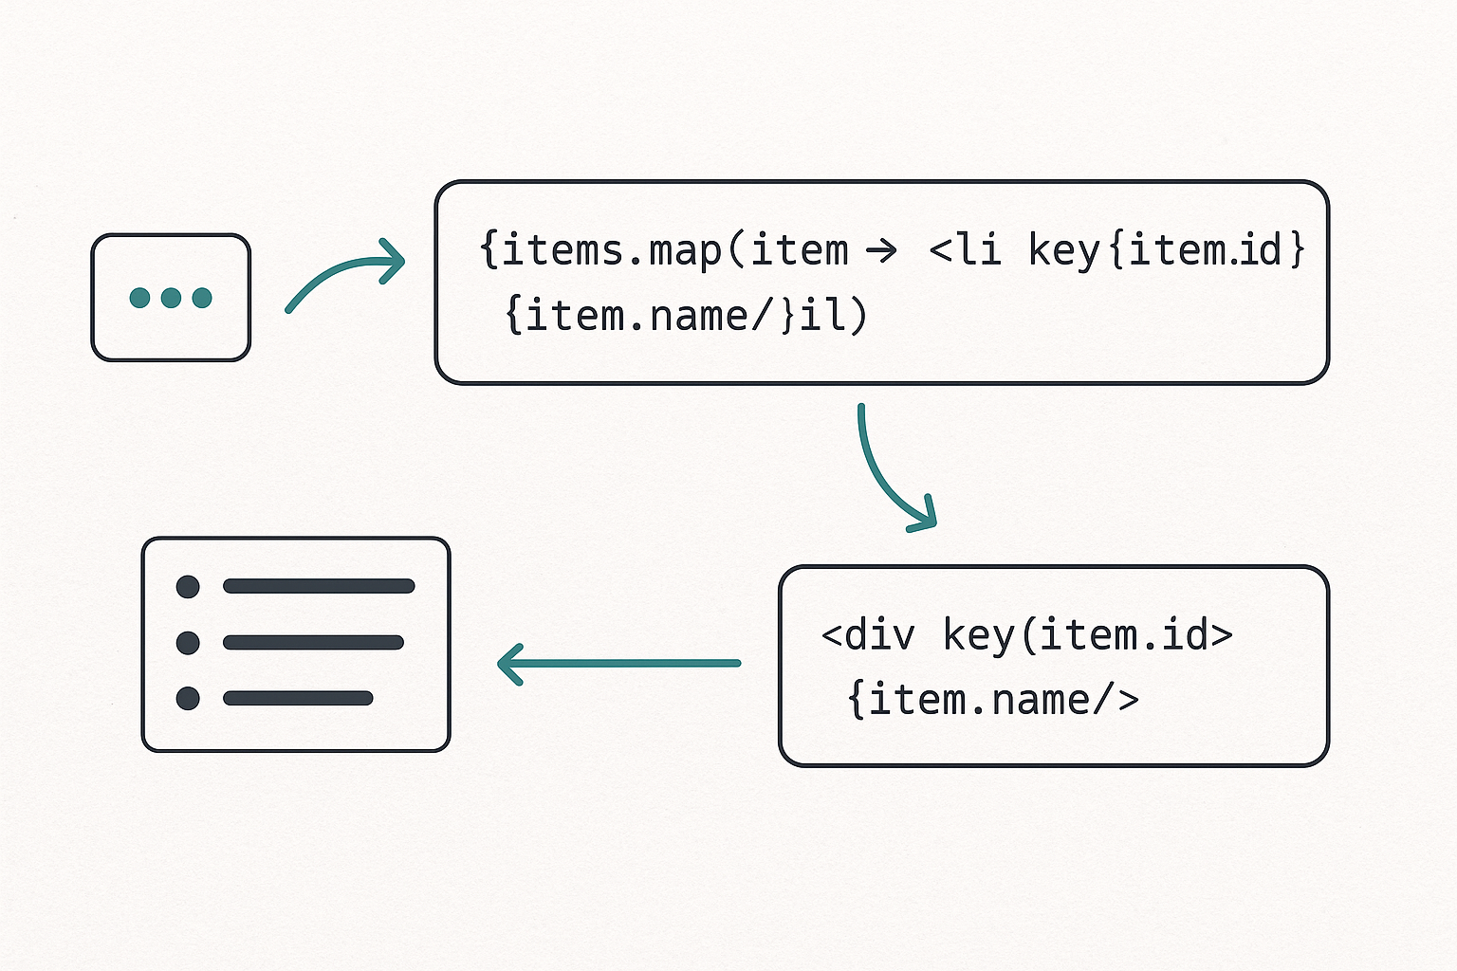
19. Map Method
1. Purpose: Dynamically display array data using JSX
2. JSX Mapping: Use .map() to convert each item into a JSX element.
{items.map(item => <li key={item.id}>{item.name}</li>)}
3. Inline Rendering: Render directly within JSX — no separate function needed.
4. Key Prop: Assign a unique key to each element for optimized re-renders.
Example: <div key={item.id}>{item.name}</div>
5. Why Key Matters: Helps React track items efficiently and improve performance.

Slide 29
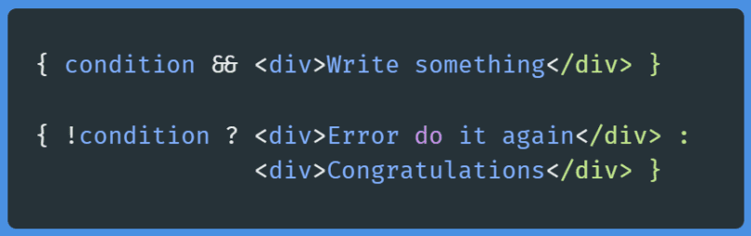
20. Conditional Rendering
Conditional Rendering
Displaying content based on certain conditions.
Allows for dynamic user interfaces. Methods
If-else statements: Choose between two blocks of content.
Ternary operators: Quick way to choose
between two options.
Logical operators: Useful for rendering content when a condition is true.
Benefits
Enhances user experience.
Reduces unnecessary rendering.
Makes apps more interactive and responsive.

Slide 30
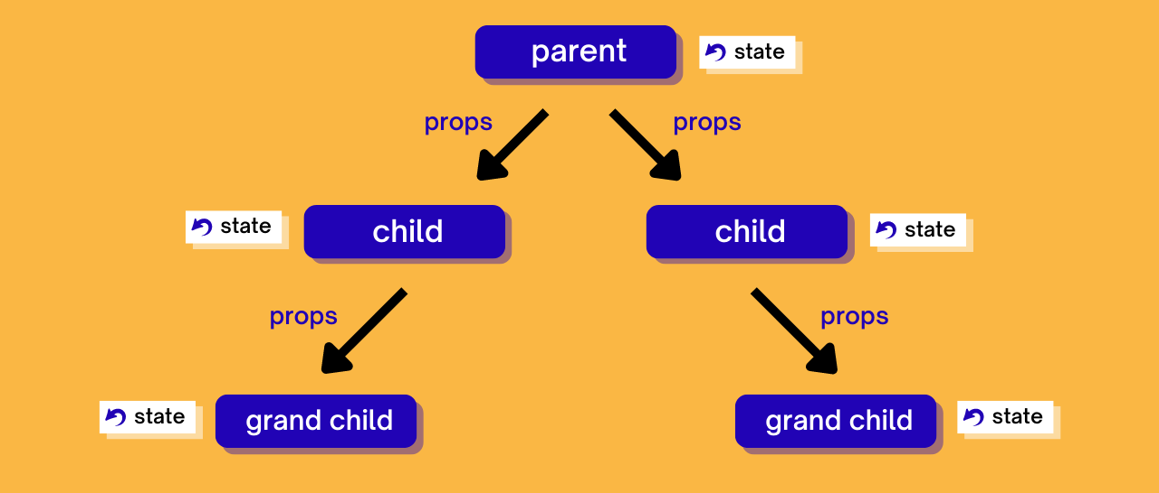

21. Passing Data via Props
Props in React
Short for properties
Mechanism for passing data.
Read-only by default Usage
Pass data from parent to child component.
Makes components reusable.
Defined as attributes in JSX. Key Points
Data flows one-way (downwards).
Props are immutable.
Used for communication between components. Examples
<Header title="My App" />

Slide 31
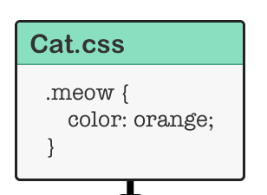
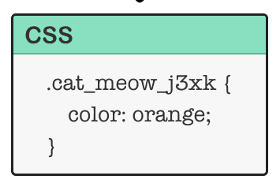

22. CSS Modules
Localized class names to avoid global conflicts.
Styles are scoped to individual components.
Helps in creating component-specific styles.
Automatically generates unique class names.
Promotes modular and maintainable CSS.
Can use alongside global CSS when needed.

Slide 32
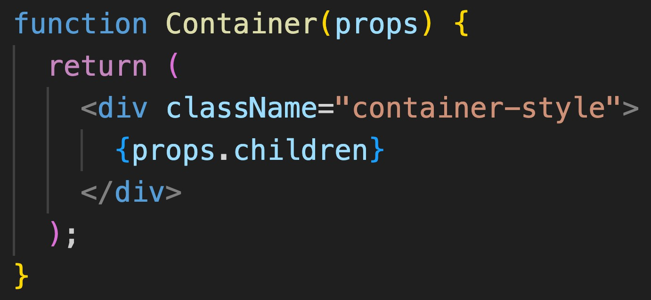
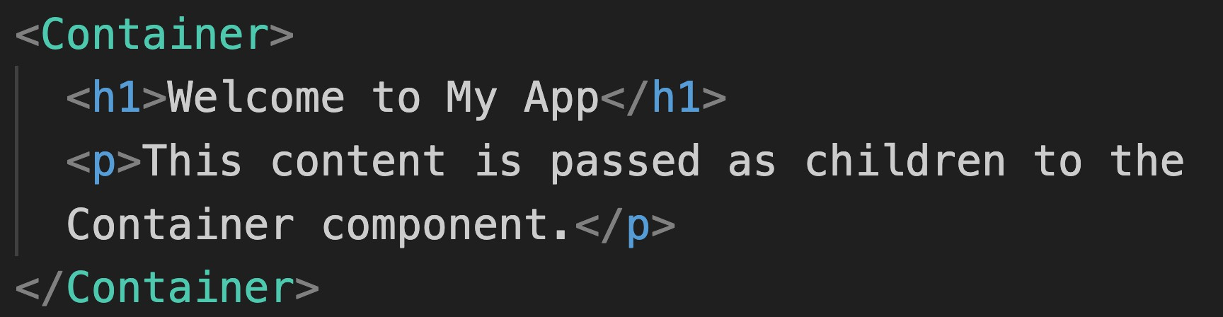
23. Passing Children
children is a special prop for passing elements into components.
Used for flexible and reusable component designs.
Common in layout or container components.
Accessed with props.children.
Can be any content: strings, numbers, JSX, or components.
Enhances component composability and reusability.

Slide 33
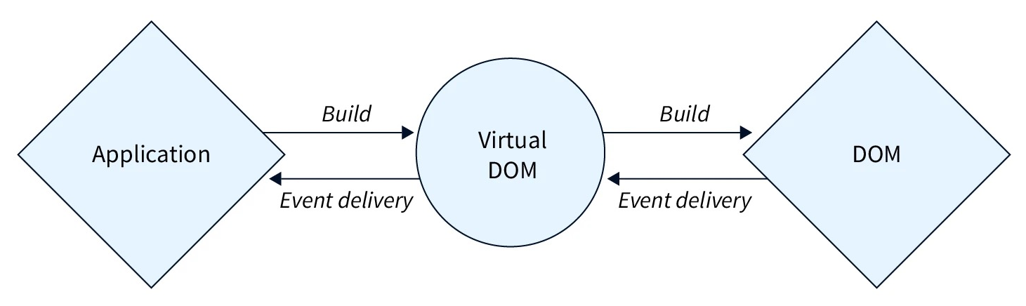
24. Handling Events
React events use camelCase, e.g., onClick.
Uses synthetic events, not direct browser events.
Event handlers can be functions or arrow functions.
Use onChange for controlled form inputs.
Avoid inline arrow functions in JSX for performance.

Slide 34
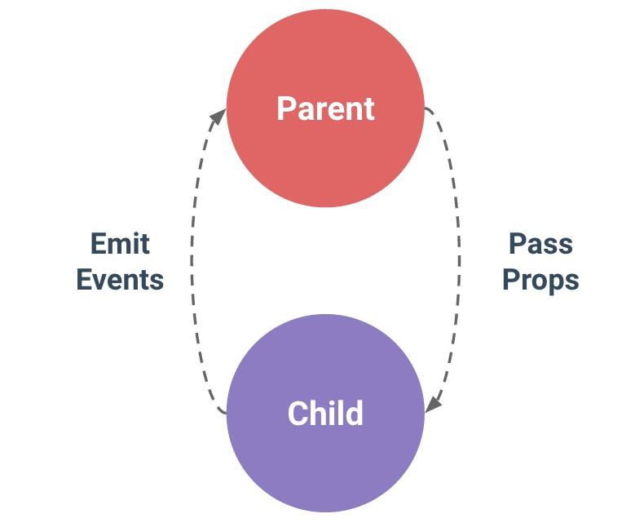
25. Passing Functions via Props
Pass dynamic behaviour between components.
Enables upward communication from child to parent.
Commonly used for event handling.
Parent defines a function, child invokes it.
Enhances component interactivity.
Example:
<Button onClick={handleClick} />

Slide 35
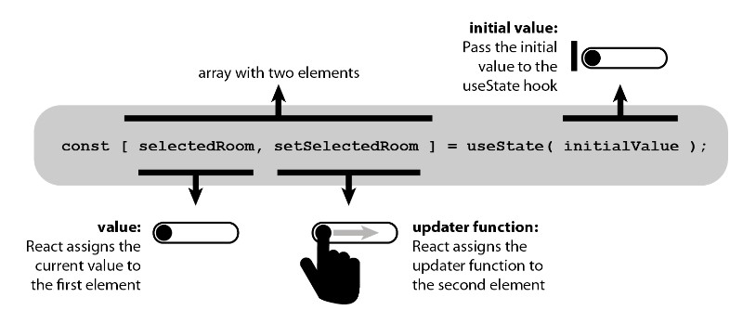
26. Managing State
State represents data that changes over time.
State is local and private to the component.
State changes cause the component to re-render.
For functional components, use the useState hook.
React Functions that start with word use are called hooks
Hooks should only be used inside components
Parent components can pass state down to children via props.
Lifting state up: share state between components by moving it to their closest common ancestor.

Slide 36
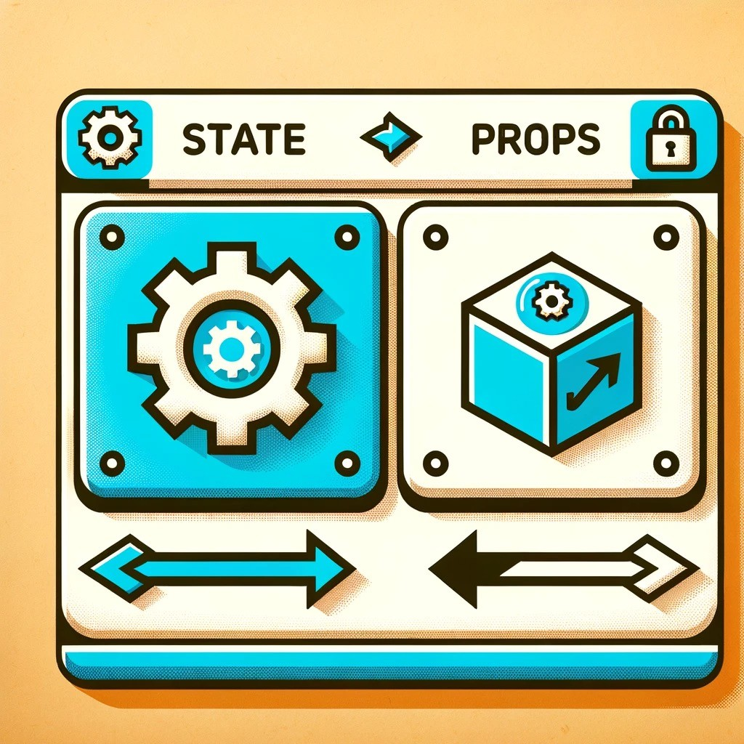
27. State vs Props
State:
Local and mutable data within a component.
Initialized within the component.
Can change over time.
Causes re-render when updated.
Managed using useState in functional components.
Props:
Passed into a component from its parent.
Read-only (immutable) within the receiving component.
Allow parent-to-child component communication.
Changes in props can also cause a re-render.

Slide 37
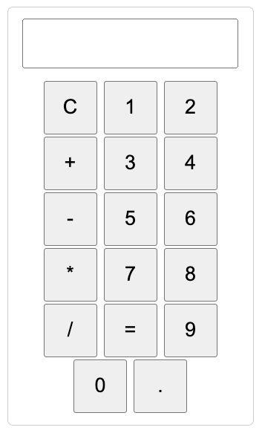
Project Calculator & TODO App

Slide 38
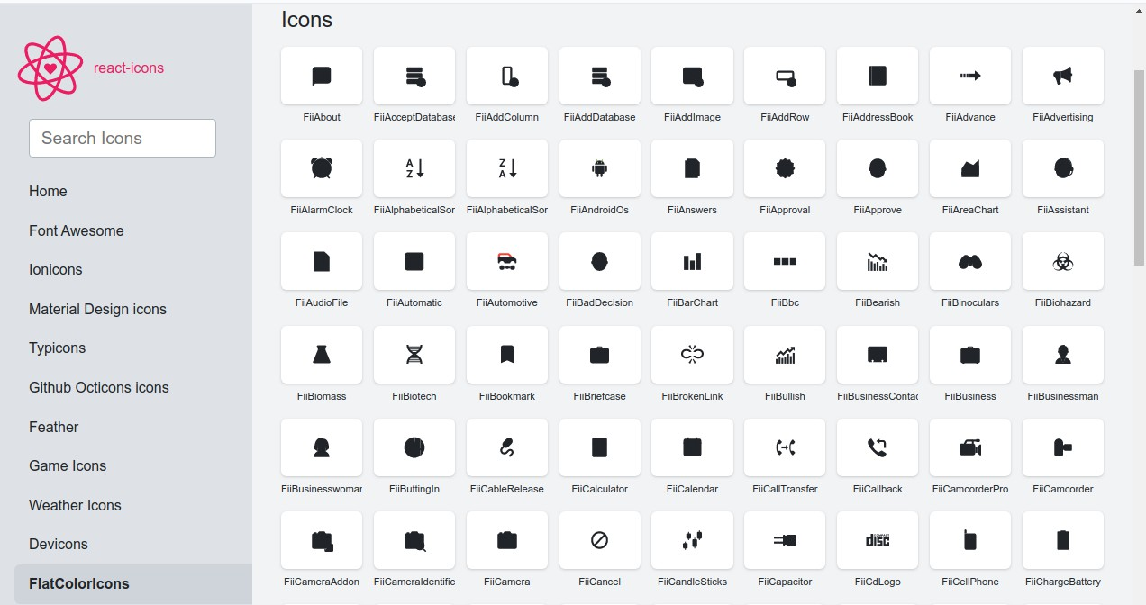
28. React-icon Library
You can use a lot of icons without managing them.
Install Package: npm install react-icons –save
Use icon:
import {IconName} from "react-icons/fc";

Slide 39
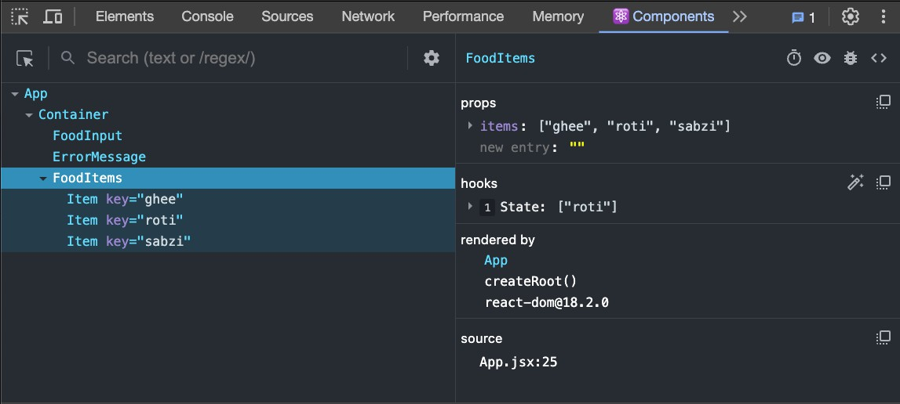
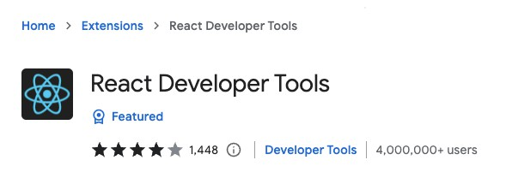
29. Inspecting with React Dev Tools
Inspection: Allows inspection of React component hierarchies.
State & Props: View and edit the current state and props of components.
Performance: Analyze component re-renders and performance bottlenecks.
Navigation: Conveniently navigate through the entire component tree.
Filtering: Filter components by name or source to locate them quickly.
Real-time Feedback: See live changes as you modify state or props.

Slide 40

30. How React Works
Root Component:
The App is the main or root component of a React application.
It's the starting point of your React component tree.
Virtual DOM:
React creates an in-memory structure called the virtual DOM.
Different from the actual browser DOM.
It's a lightweight representation where each node stands
for a component and its attributes.
Reconciliation Process:
When component data changes, React updates the
virtual DOM's state to mirror these changes.
React then compares the current and previous versions of
the virtual DOM.
It identifies the specific nodes that need updating.
Only these nodes are updated in the real browser DOM,
making it efficient.

Slide 41

30. How React Works
React and ReactDOM:
The actual updating of the browser's DOM isn't done by React itself.
It's handled by a companion library called react-dom.
Root Element:
The root div acts as a container for the React app.
The script tag is where the React app starts executing.
If you check main.tsx, the component tree is rendered inside this
root element.
Strict Mode Component:
It's a special component in React.
Doesn't have a visual representation.
Its purpose is to spot potential issues in your React app.
Platform Independence:
React's design allows it to be platform-agnostic.
While react-dom helps build web UIs using React, ReactNative can be used to craft mobile app UIs.

Slide 42

31. React Vs Angular vs Vue
React, Angular, and Vue:
React is a library, while Angular and Vue.js are frameworks.
React focuses on UI; Angular and Vue.js offer comprehensive tools for full app development.
Library vs. Framework:
A library offers specific functionality.
A framework provides a set of tools and guidelines.
In simpler terms: React is a tool; Angular and Vue.js are toolsets.
React's Specialty:
React's main role is crafting dynamic, interactive UIs.
It doesn't handle routing, HTTP calls, state management, and more.
React's Flexibility:
React doesn't dictate tool choices for other app aspects.
Developers pick what fits their project best.
About Angular and Vue.js:
Angular, developed by Google, provides a robust framework with a steep learning curve.
Vue.js is known for its simplicity and ease of integration, making
it beginner-friendly.

Slide 43

32. Using Forms
State Management: Each input's state is stored in the component's state.
Handling Changes: Use onChange to detect input changes.
Submission: Utilize onSubmit for form submissions and prevent default with event.preventDefault().
Validation: Implement custom
validation or use third-party libraries.

Slide 44
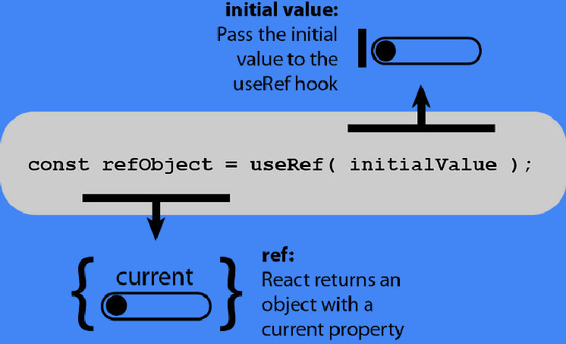
33. Use Ref
useRef allows access to DOM elements and retains mutable values without re-renders.
Used with the ref attribute for direct DOM interactions.
Can hold previous state or prop values.
Not limited to DOM references; can hold any value.
Refs can be passed as props also

Slide 45

34. Update state from Previous State
Spread Operator: Use to maintain immutability when updating arrays or objects.
Functional Updates: Use
(existingPosts) => [postData, ...existingPosts] to avoid stale values during asynchronous updates.

Slide 46
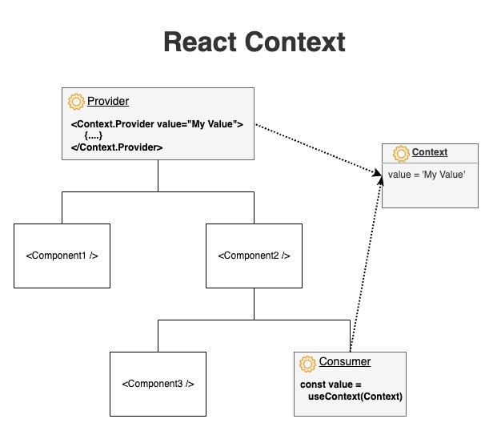
35. Context API
Prop Drilling: Context API addresses prop drilling; component composition is an alternative.
Folder Setup: Use a store folder for context files.
Initialization: Use React.createContext with initial state and export it.
Provider: Implement with contextName.Provider in
components.
Access Value: Use the useContext hook.
Dynamic Data: Combine context value with state.
Export Functions: Context can also export functions for actions
Logic Separation: This helps keep the UI and business
logic separate from each other.

Slide 47
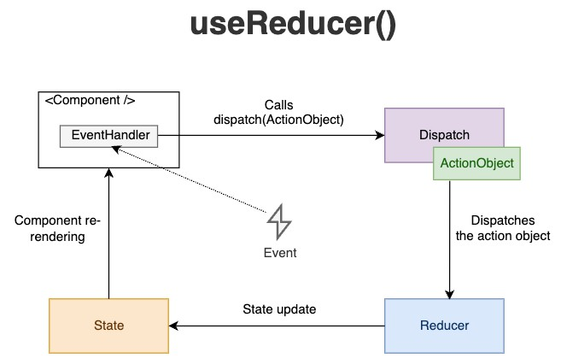
36. Use Reducer
useReducer is a hook in React that offers more control over state operations compared to useState, especially for complex state logic.
Components: It involves two main components:
Reducer: A pure function that takes the current state and an action and returns a new state.
Action: An object describing what happened, typically having a type property.
Initialization: It's invoked as
const [state, dispatch] = useReducer(reducer, initialState).
Dispatch: Actions are dispatched using the dispatch function, which invokes the reducer with the current state and the given action.
Use Cases: Particularly useful for managing state in large components or when the next state depends on the previous one.
Predictable State Management: Due to its strict structure, it leads to more predictable and maintainable state
management.

Slide 48
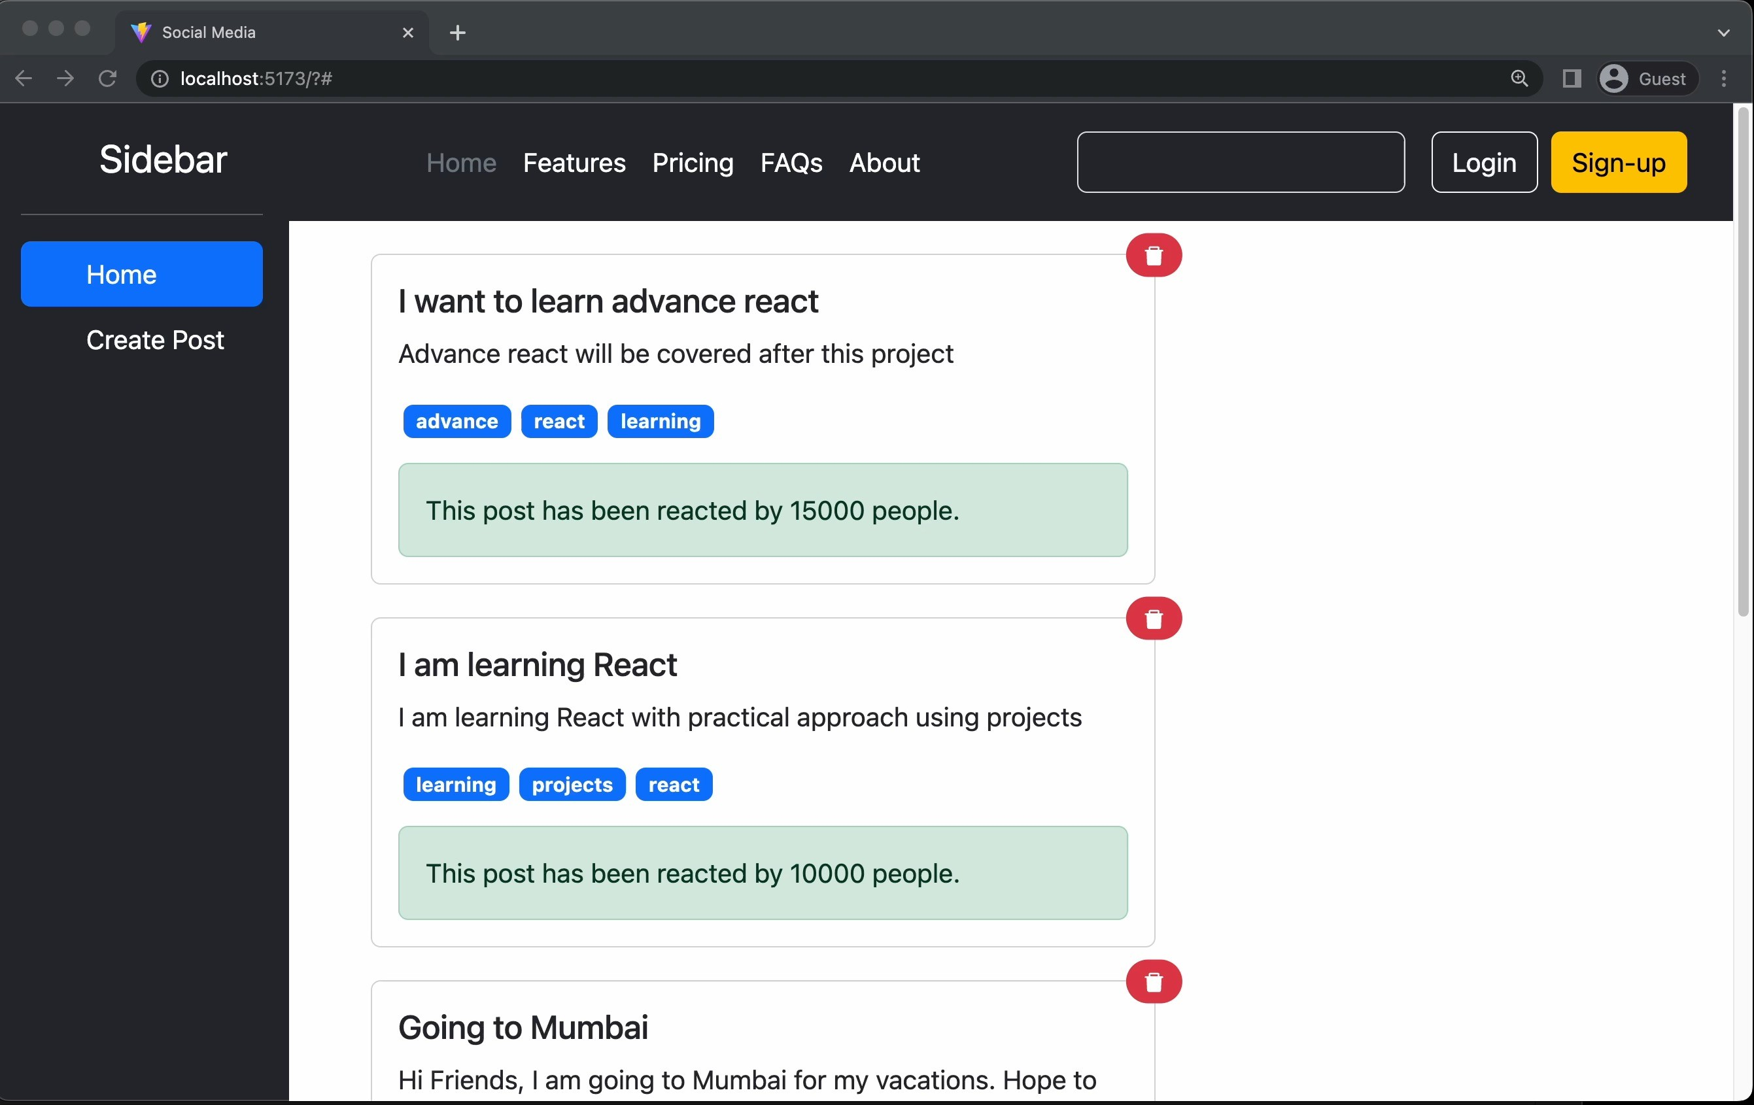
Project: Social Media

Slide 49
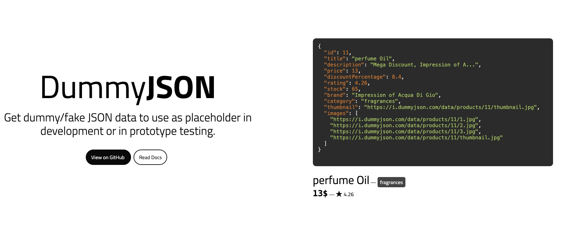
37. Introducing Dummy API

Slide 50

38. Data fetching using Fetch
fetch: Modern JavaScript API for network requests.
Promise-Based: Returns a Promise with a Response object.
Usage: Default is GET. For POST use method: 'POST'
Response: Use .then() and response.json() for JSON data.
Errors: Doesn't reject on HTTP errors. Check response.ok.
Headers: Managed using the Headers API.

Slide 51
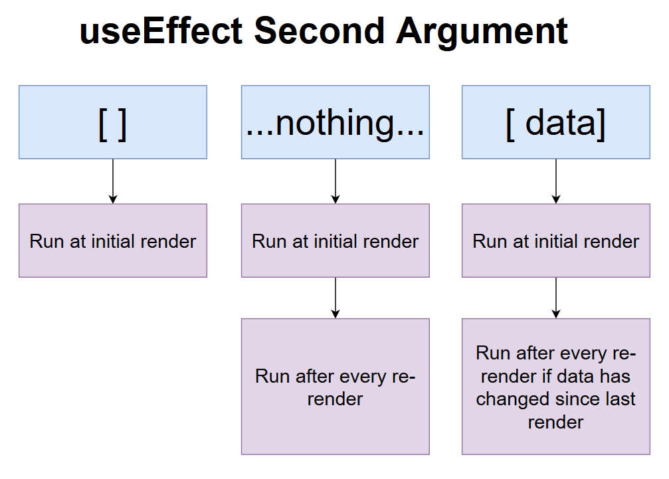
39. The useEffect Hook
In function-based components, useEffect handles side effects like data fetching or event listeners.
useEffect runs automatically after every render by default.
By providing a dependency array, useEffect will only run when specified variables change. An empty array means the effect runs once.
Multiple useEffect hooks can be used in a single component for organizing different side effects separately.

Slide 52
39. More About useEffect Hook
The useEffect hook becomes important when your component needs to
react to changes, interact with external systems, or perform side effects like:
Fetching data from an API
Setting up a subscription (e.g. WebSocket)
Listening to window events (scroll, resize)
Updating the document title or localStorage
Handling timers (setInterval, setTimeout)

Slide 53

40. Handling Loading State

Slide 54
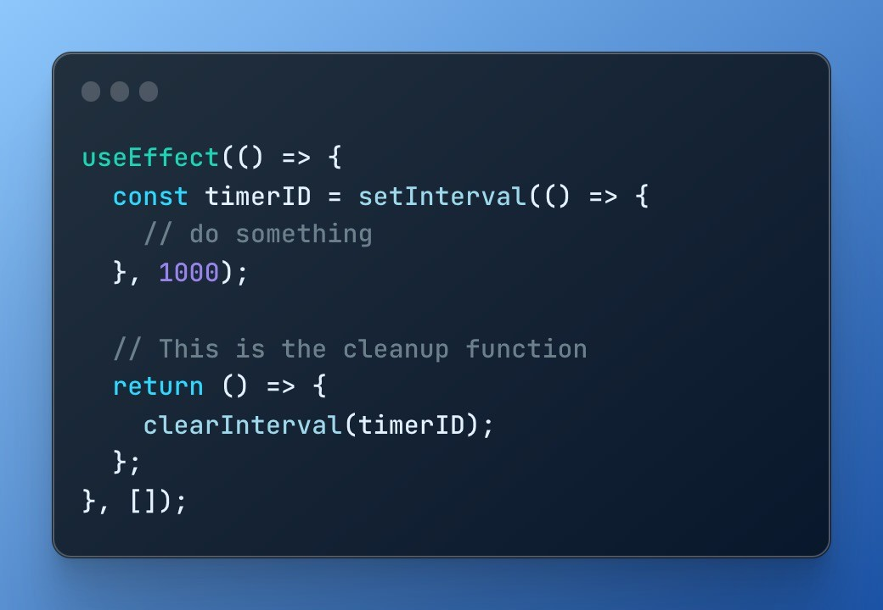
41. The useEffect Hook Cleanup
Returning a function from `useEffect` allows for cleanup, ideal for removing event listeners.

Slide 55
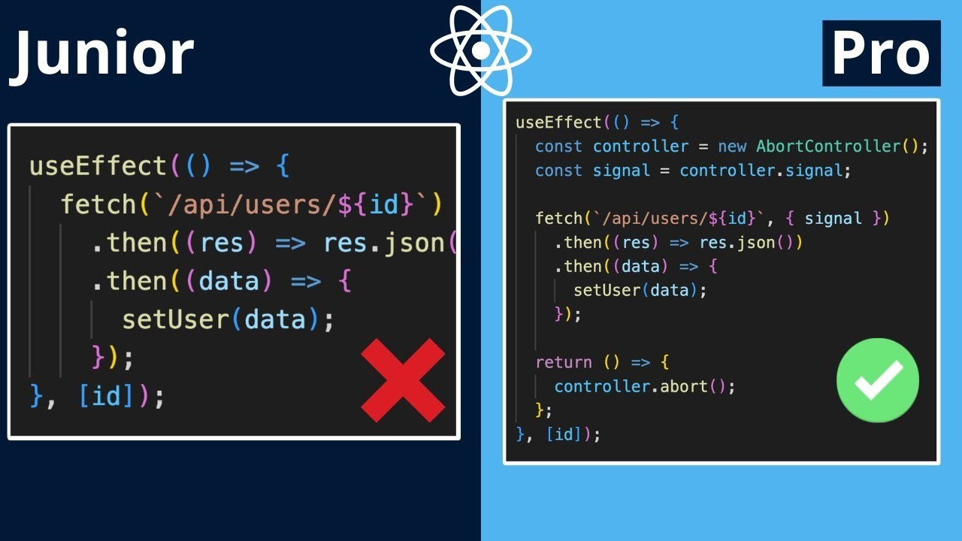
42. Advanced useEffect

Slide 56
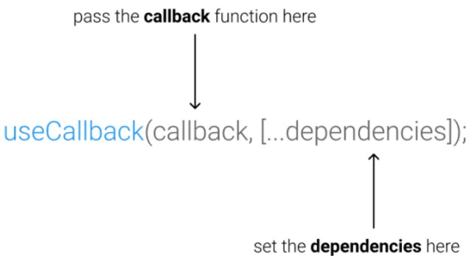
43. The useCallback Hook
Memoization: Preserves function across renders to prevent unnecessary re-renders.
Optimization: Enhances performance in components with frequent updates.
Dependency Array: Recreates the function only when specific dependencies change.
Event Handlers: Used to keep consistent function references for child components.
With useEffect: Prevents infinite loops by maintaining function references.

Slide 57
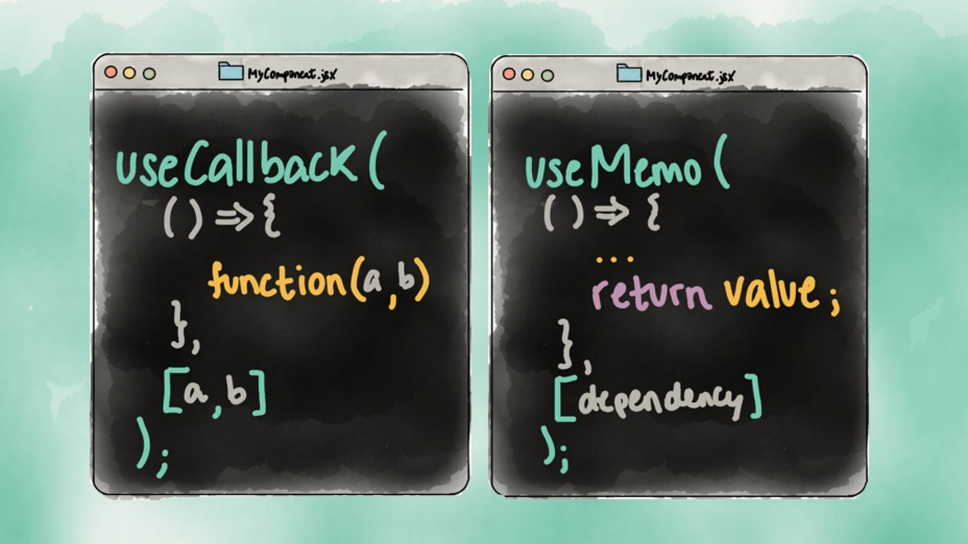
44. The useMemo Hook
Memoization: useMemo caches the result of expensive calculations to enhance performance.
Re-computation: Only re-computes the memoized value when specific dependencies change.
Optimization: Helps prevent unnecessary recalculations, improving component rendering efficiency.
Dependency Array: Uses an array of dependencies to determine when to recompute the cached value.
Comparison with useCallback: While useCallback memoizes functions, useMemo memoizes values or results of functions.
Best Use: Ideal for intensive computations or operations that shouldn't run on every render.

Slide 58
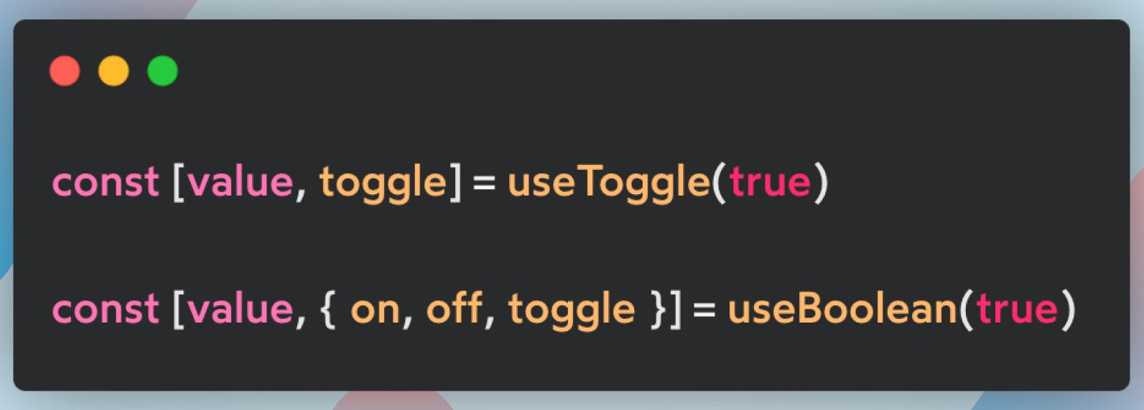
45. Custom Hooks
Reusable Logic: Custom hooks allow you to extract and reuse component logic across multiple components.
Naming Convention: Typically start with "use" (e.g., useWindowSize, useFetch).
Combining Hooks: Custom hooks can combine multiple built-in hooks like useState, useEffect,
and others.
Sharing State: Enables sharing of stateful logic without changing component hierarchy.
Isolation: Helps in isolating complex logic, making components cleaner and easier to maintain.
Custom Return Values: Can return any value
(arrays, objects, or any other data type) based on requirements.

Slide 59
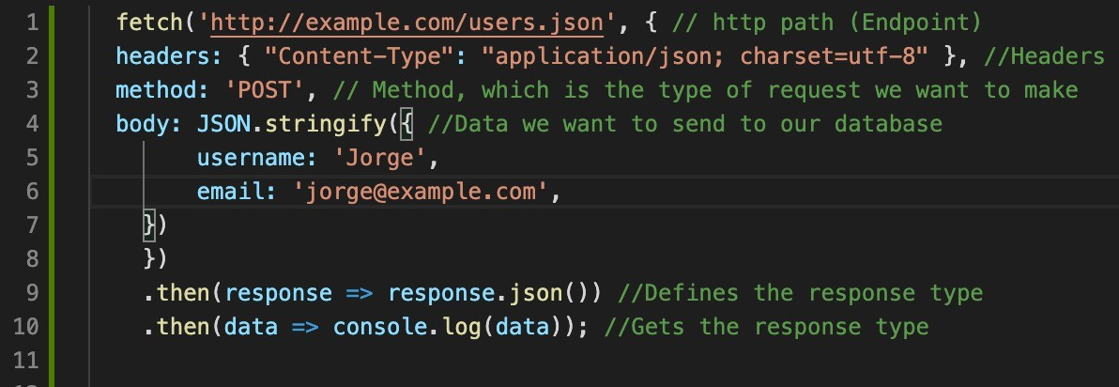
46. Submitting data with Fetch

Slide 60
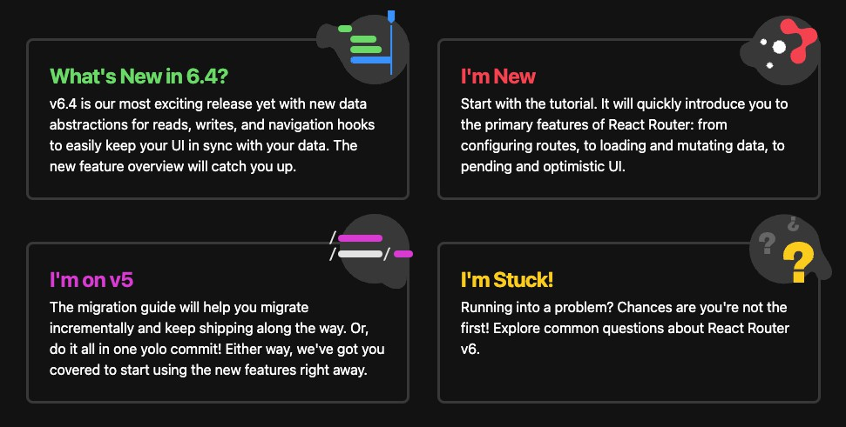
47. React Router
Installation: Use npm install react-router-dom.
We are going to use the latest version which is 6+
RouterProvider: Wraps the app for routing capabilities.
createBrowserRouter: helps creating the mapping for router provider.
Declarative Routing: Easily define application routes.
Routes are React components.

Slide 61
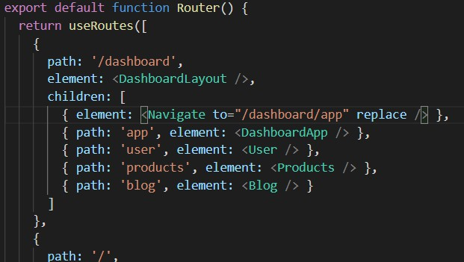
48. Layout Routes
Layout Routes help us to use shared elements
Outlet component is used to render the children at the correct places

Slide 62
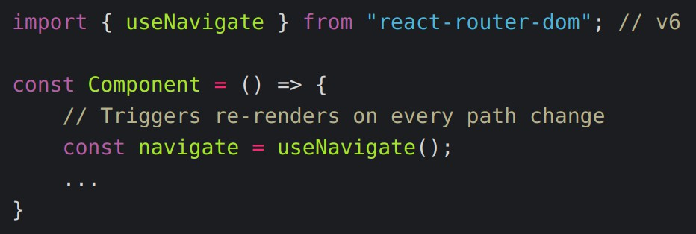
49. Route Links
Link Component with to property can be used to avoid reloading
useNavigate hook can be used to do navigation programmatically.

Slide 63
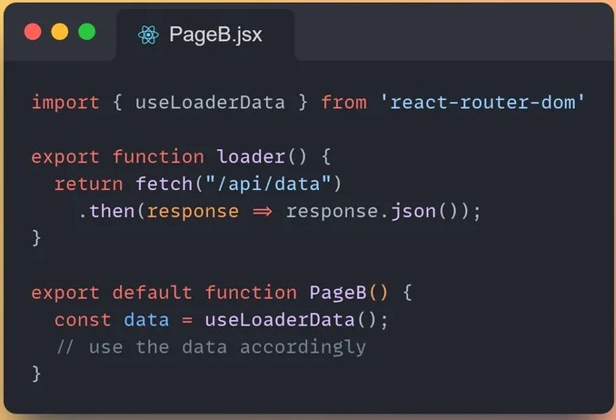
50. Data fetching using loader
Loader method can be used to load data before a particular route is executed.
The loader method must return the data that is loaded or promise.
Data is available in component and all the child components.
useLoaderData hook can be used to get the fetched data.
Loading state can also be used.

Slide 64

51. Submitting data using action
Action method can be used to perform an action on submission of Forms.
Custom Form component need to be used along with name attribute for all inputs.
Action function will get an data object. To generate correct request object method=“post” attribute should be used.
Data.request.formData() method can be
used to get form data Object.
Object.fromEntries(formData) can be used to get actual input data.
redirect() response can be returned for navigation after submission.

Slide 65
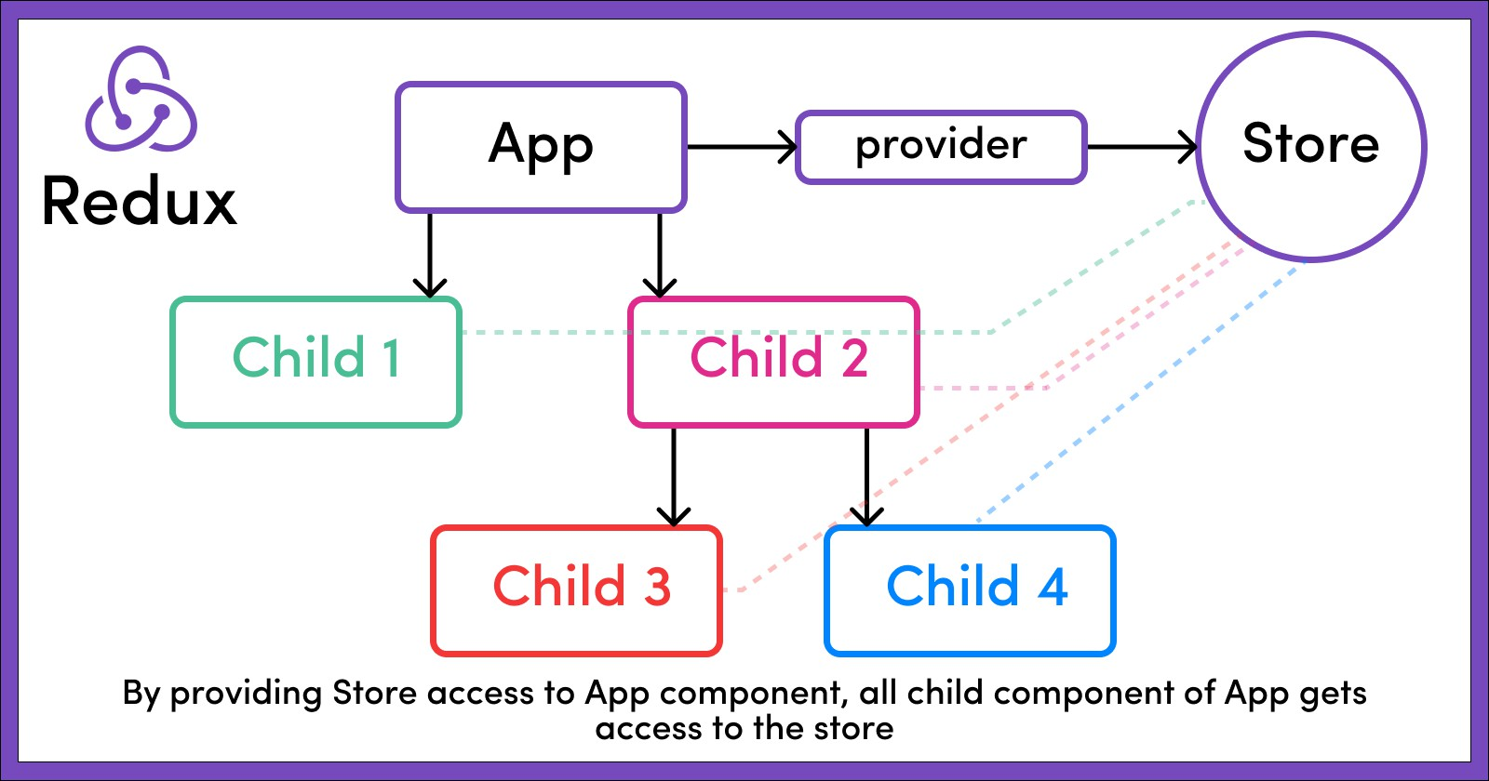
52. What is Redux
State management for cross component or app-wide state.
Redux is a predictable state management library for JavaScript apps.
Local State vs Cross-component state vs App-Wide state
useState or useReducer vs useState with prop drilling vs useState or useContext or Redux.

Slide 66
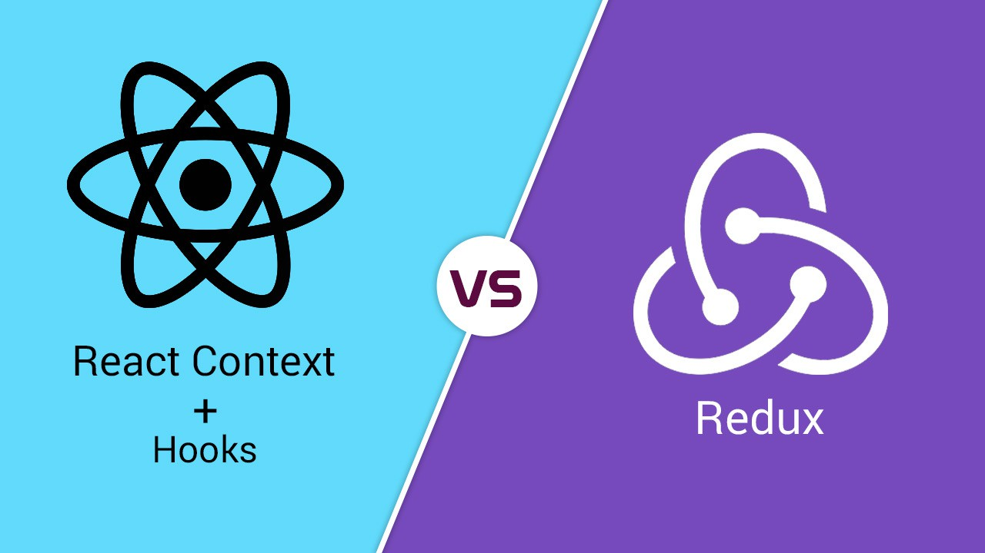
53. React-Context vs Redux
You can use both.
Setup and Coding is tough especially if you have multiple context providers.
Performance is slow. Context should only be used for things that rarely change. On the other hand Redux has great performance.
If these things don’t matter to you then you can choose not to use redux
and stay with React-Context.

Slide 67
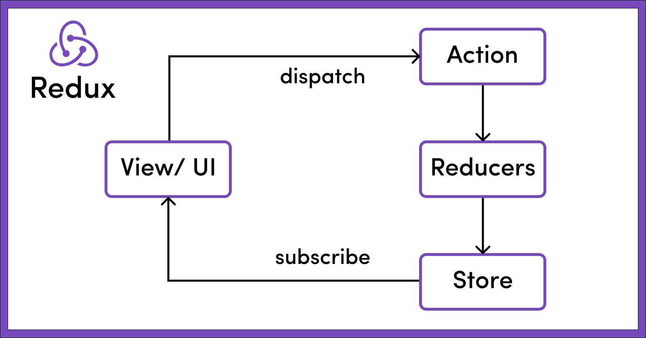
54. How Redux Works
Single Source: Uses a single central store to maintain the entire application's state.
Actions: Components never directly change the store. Changes to state are made through
dispatched actions, which describe events.
Reducers: Actions are processed by reducers, pure functions that return the new state.
Immutable: State is immutable; every change results in a new state object.
This is different from useReducer hook.

Slide 68
55. Working with Redux
npm init –y
npm install redux
import in node Const redux = require(‘redux’);
We need to setup all 4 basic things:
Reducer
Store
Subscriber
Actions
Node redux-demo.js command to run node server

Slide 69
56 React with Redux
Npm install redux
Npm install react-redux
Create store folder with Index.js file
Creating the store using
Import {createStore} from redux.
Providing the store with react
Provider from react-redux
<Provider store={store}><App /></Provider>
Using the store
useSelector hook gets a slice of the store.
Const counter = useSelector(state => state.counter);
Subscription is already setup and only will re-execute when only your slice is changed. Subscription is
automatically cleared also.
Dispatch Actions using the useDispatch hook.

Slide 70

57. Why Redux Toolkit
Action types are difficult to maintain.
Store becoming too big.
Mistakenly editing store.
Reducer becoming too big.

Slide 71
58 Working with Redux Toolkit
Npm install @reduxjs/toolkit
Remove redux from package.json
Import {createSlice} from “@reduxjs/toolkit”
Slices of the store can be created using the following syntax:
Const slice = createSlice({ name: ‘’,
initialState: {}, reducers: {
smallReducerMethods: (state, action) => {
},
}
})
ConfigureStore combines multiple reducers and can be used as: configureStore({
reducer: {name: slice.reducer}
})
Export actions = slice.actions;
Actions can be dispatched like: actions.reducerMethod(payload);

Slide 72
About Me
💬 Let’s Connect
I’d love to hear from you, collaborate, or simply connect over tech and ideas. Feel free to explore more or reach out through the links below.
🌐Portfolio 🐱GitHub 🔗Linkedin 🖇️Instagram
🧑‍💻Keep Learning. Keep Building.
Thanks again for reading — wishing you continued success and growth in your development journey!
— Rishabh Singh

